Slide 1




SMART HELMET
PROJECT
Enhancing Safety and Convenience with Integrated Smart Technology
ZapOnyx

Slide 2

01
02
03
Project Objective
Key Innovations Overview
Accident Detection & Location Sharing
04
05
06
SOS & Location Sharing
Hands-Free Call Management
Virtual Assistant Integration
OVERVIEW
07
08
09
Technical Components
Mobile Application
Market Impact
10
11
12
Benefits for Humankind
Challenges & Solutions
Our Team &
Conclusion

Slide 3


PROJECT OBJECTIVE
ADVANCED SAFETY FEATURES
SEAMLESS CONNECTIVITY & CONVENIENCE
The Smart Helmet goes beyond traditional protection by integrating accident detection, SOS alerts, and real-time tracking. In case of an accident, it automatically sends an SOS message and calls with the rider’s live location to emergency contacts, ensuring prompt assistance.
With hands-free calling, voice-controlled navigation, and Google Assistant integration, the helmet enhances the riding experience without distractions. A dedicated Women’s Safety SOS Button provides added security, promoting responsible riding and preventing accidents.

Slide 4

KEY INNOVATIONS OVERVIEW
Accident Detection & SOS Alerts - Detects accidents and automatically sends emergency messages and calls with live location.
01
02
Hands-free Calling - Answer or end calls using voice commands or buttons for a safer ride.
03
Google Assistant Integration - Control calls, navigation, and reminders hands-free
04
Real-time Location Tracking - Enables loved ones to monitor your ride for safety.
05
Women’s Safety SOS Button - Sends instant emergency alerts with live location for immediate assistance.

Slide 5
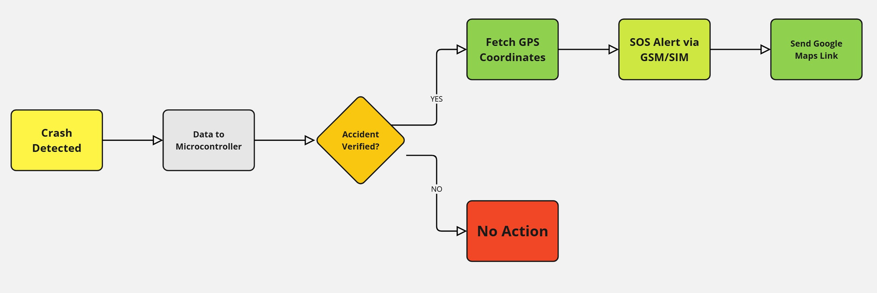
ACCIDENT DETECTION
Emergency Alerts Sent Using Moblie Application
Sensors detect sudden speed changes, abnormal orientation changes, and GPS module locations. The crash detection mechanism uses algorithm-based thresholds and machine learning to analyze crash patterns and reduce false positives.
Use Neo 6m
GPS Module

Slide 6

SOS & LOCATION SHARING
The Smart Helmet features an SOS and Location Sharing system for rider safety.
In case of an accident or fall, the helmet automatically detects impact using sensors.
An SOS alert is sent to pre-added emergency contacts, including family members, the nearest police station, and the nearest hospital via the Smart Helmet App.
The rider's real-time location is shared instantly for quick assistance.
If the rider’s phone is damaged, the helmet sends the last known location before impact.
Live tracking allows family members to monitor the rider’s journey in real time.
- Ensures faster emergency response and timely medical help.

Slide 7

REAL TIME LOCATION TRACKING
INTEGRATED GPS SYSTEM
The Smart Helmet comes with built-in GPS for real-time location tracking.
LIVE LOCATION SHARING
Riders can share their location with family or emergency contacts for added security.
EMERGENCY ASSISTANCE
In case of an accident, the helmet automatically sends the rider’s location to preset contacts.
INTEGRATED GPS SYSTEM
Ensures that loved ones can track the rider’s journey, reducing safety concerns.

Slide 8


SOS BUTTON FOR WOMEN'S SAFETY
The Smart Helmet includes a dedicated SOS button designed specifically for women’s safety.
If a rider feels threatened, harassed, or is being chased, they can press the SOS button to trigger an emergency alert.
The helmet instantly sends an SOS message and real-time location to emergency contacts, the nearest police station, and the women's safety helpline.
This feature ensures quick police response and immediate help in dangerous situations.
If the rider’s phone is damaged or taken away, the helmet will still send the last known location before losing connection.
Provides enhanced security, quick assistance, and peace of mind, especially for women riding alone.

Slide 9


12
HANDS-FREE CALLING
CALL RECEIVE
The helmet is equipped with an ESP32 microcontroller and a push button, allowing users to answer calls with a single click. By leveraging Bluetooth connectivity, the ESP32 pairs with a smartphone, enabling seamless communication without the need to touch the phone. This feature is particularly beneficial for motorcyclists, delivery riders, and safety-conscious users, ensuring they can stay connected while keeping their hands on the handlebars and eyes on the road.
CALL DECLINE
The helmet features an ESP32 microcontroller and a push button, enabling users to answer calls with a single click and decline them with a double click. With Bluetooth connectivity, the ESP32 seamlessly pairs with a smartphone, allowing hands-free communication without any physical interaction with the phone. This functionality is especially useful for motorcyclists, delivery riders, and safety-conscious users, ensuring they stay connected while keeping their hands on the handlebars and their focus on the road.

Slide 10
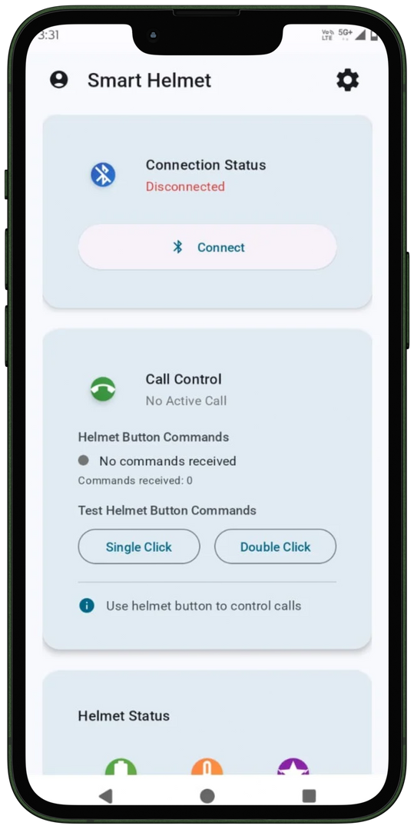
OUR MOBILE APPLICATION (HOME PAGE)
CONNECT BUTTON
The helmet is connected via Bluetooth pairing.
HANDS FREE CALLING
This feature enables hands-free calling via ESP32 and Bluetooth, allowing call control with a single or double button click.
HELMET MONITORING
This feature gives information about the helmet, like battery, temperature, and exact impact, which makes it convenient for the user.

Slide 11
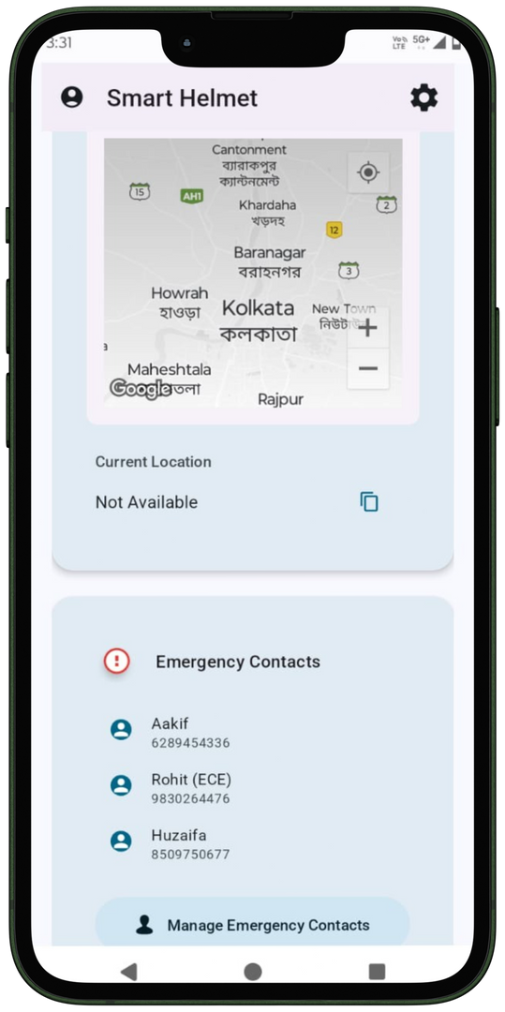
OUR MOBILE APPLICATION (Home Page)
LIVE LOCATION TRACKING
This feature shows the riders their live location and catches the track record of the rider.
ADD TO EMERGENCY CONTACTS
The user can add the emergency contact by name and mobile number or choose the contact from their contact list.

Slide 12
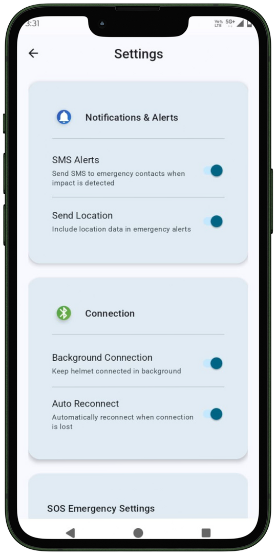
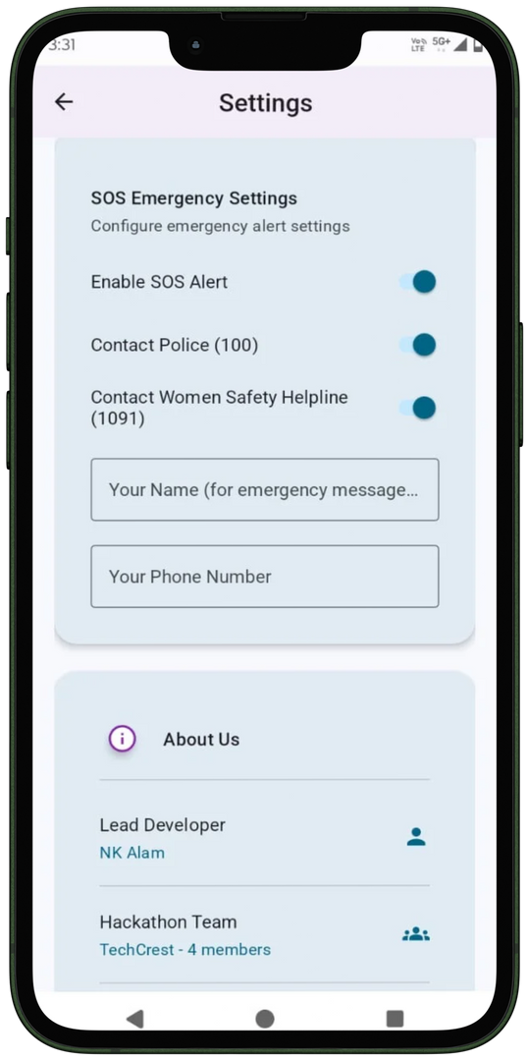
OUR MOBILE APPLICATION (SETTING PAGE)
NOTIFICATION & ALERTS
This feature allows users to enable or disable SMS alerts and send real-time location during SOS situations, ensuring flexibility and safety.
CONNECTION
This feature allows users to enable or disable background connectivity and ensures automatic Bluetooth reconnection for a seamless hands-free experience.
SOS EMERGENCY SETTINGS
This feature allows users to enable or disable emergency contacts, giving them full control over SOS alerts and notifications.

Slide 13



SMART AI SUPPORT
The helmet integrates with Google Assistant, Alexa, and Siri for hands-free operation.
Virtual Assistant Integration
HANDS-FREE CONTROLS
Riders can use voice commands to make calls, navigate, set reminders, and control music without using their hands.
ENHANCED SAFETY
Minimizes distractions, helping riders stay focused on the road while staying connected.
EASY ACTIVATION
Simply press a button or use a wake word for a smooth and effortless experience.

Slide 14
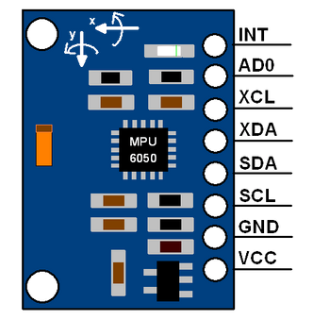

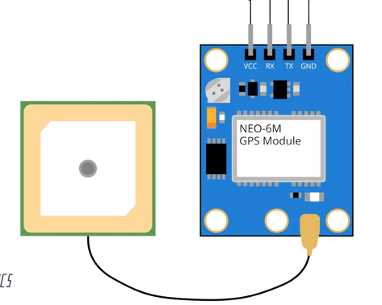
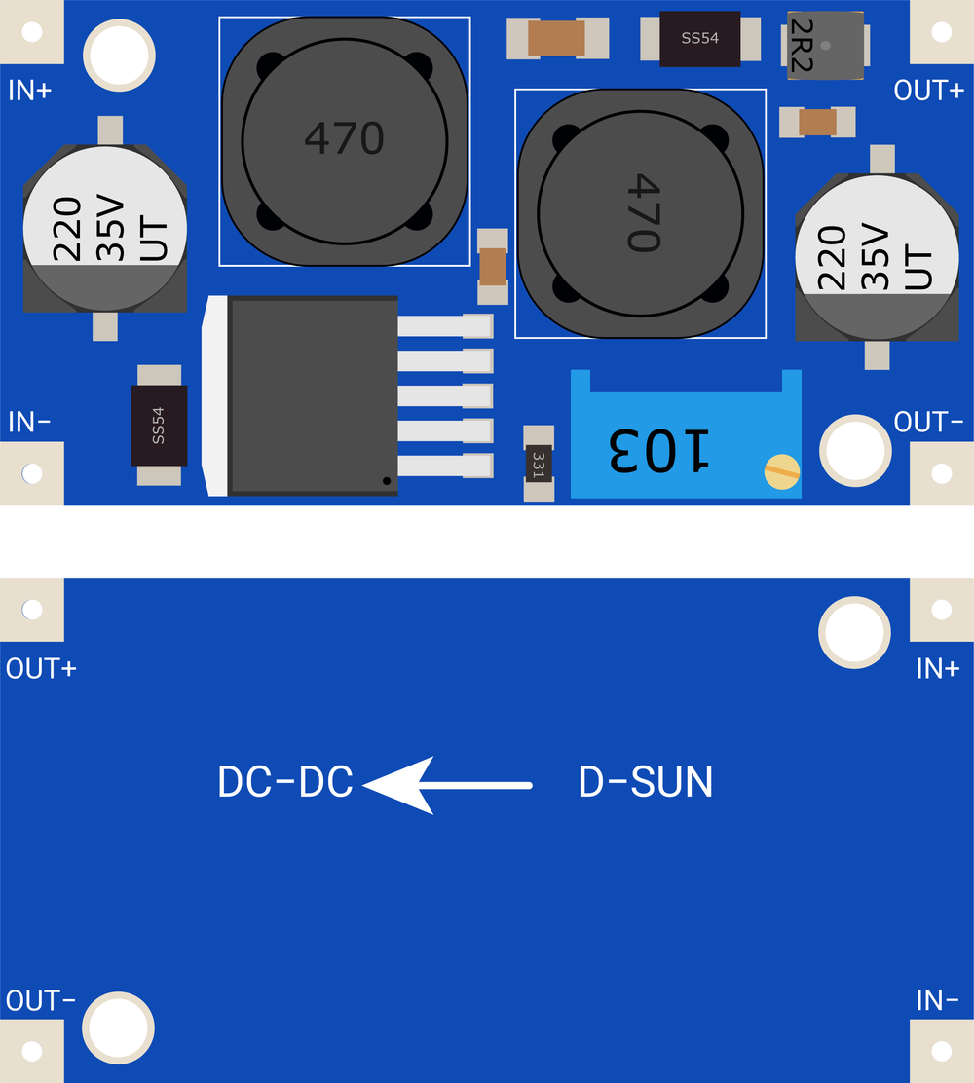
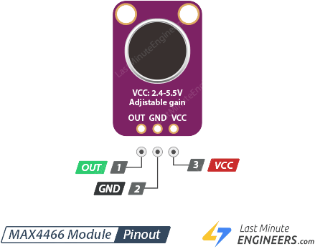
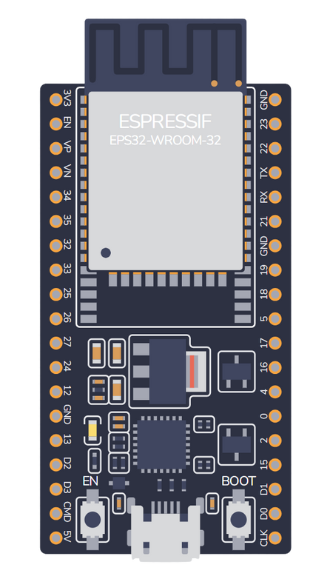
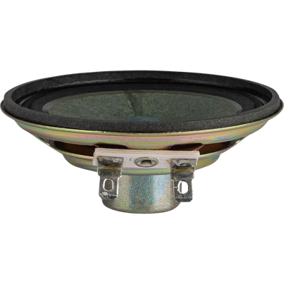
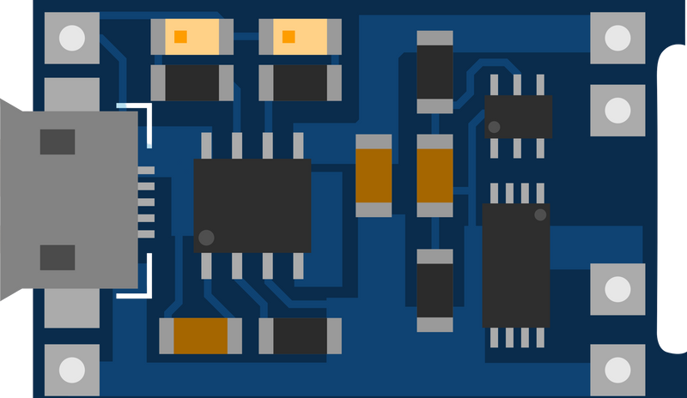
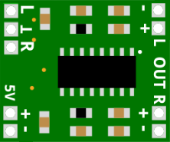
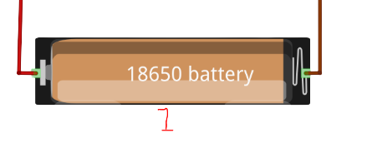
HARDWARE COMPONENTS
Neo 6m
GPS

Slide 15





OUR TEAM
SK KAIF UDDIN
AAKIF HUSAIN
ROHIT MONDAL
NUR KAUSAR ALAM
Co founder
ECE (2nd)
ECE (2nd)
ECE (2nd)
EEN (2nd)

Slide 16

THANK YOU
TECH CREST

